Slide 1
Scalable / Responsive Web Applications
Ranjit Jeyachandran

Slide 2
Part 1 : Introduction : Asynchronous Programming in C#

Slide 3
Agenda
Sync./Async Programming Models
Asynchronous Programming in Web Forms
Asynchronous Programming in MVC

Slide 4
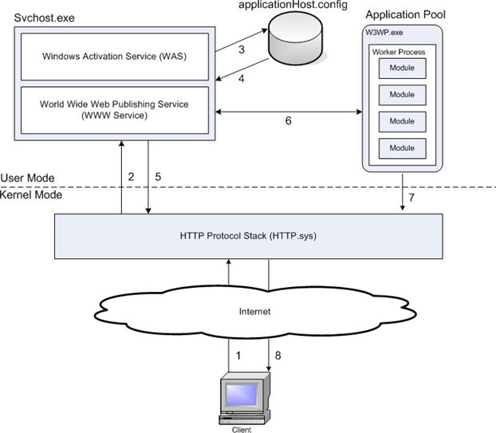
HTTP Request Processing in IIS

Slide 5
Async scenarios

Slide 6
Async – Not at the same time
It is
I/o bound workload
Database call
Web Service call
Scalability & Throughput
Responsiveness
It is not
About thread
CPU bound work loads
WPF Animation
Serialization/Deserialization
Performance
Parallel work loads
Notes:
Async scenarios:
I/O operations (database, file, network, etc.)
Parallelism
Long-running event-driven (streaming, long polling, etc.)

Slide 7
Asynchronous != parallel
Parallel
Multiple operations executing at once
Operations start/complete at different times
Sequential
Ordered set of steps
Code executes when previous operation is done
Asynchronous
Thread only blocked when there is work to do
Synchronous
Thread is blocked until execution completes

Slide 8




Traditional web request handling
Request Queue
Busy
Busy
Busy
Busy
Thread Pool

Slide 9
Synchronous Code
// table1.DataSource = LoadInstrumentsSequentially(1,5);
// table1.DataBind();
public List<Instrument> LoadInstrumentsSequentially(int first, int last)
{
var loadedInstruments = new List<Instrument>();
for (int i = first; i <= last; i++) {
Instrument instrument = Instrument.Deserialize(i);
loadedInstruments.Add(instruemnt);
}
return loadedInstruments;
}
request in
work1
work2
work3
work4
work5
response out 500ms

Slide 10
Threadpool
request in
start1
end1
start2
end2
start3
end3
start4
end4
start5
response out 500ms
end5

Slide 11
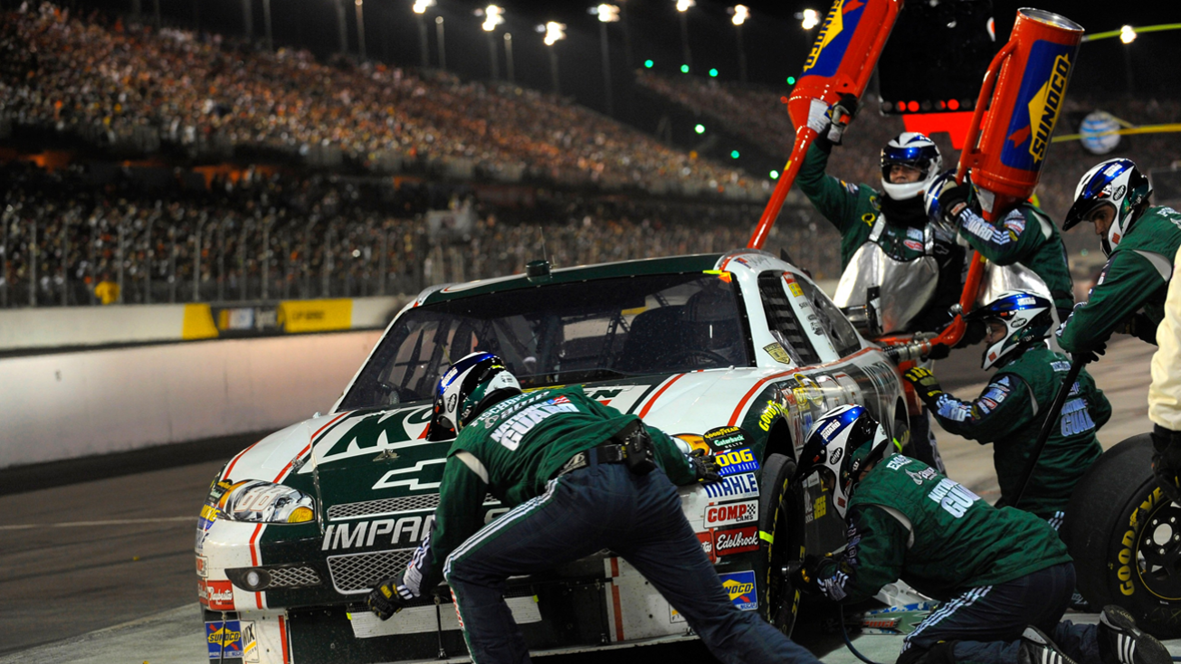



Parallel web request handling
Request Queue
Thread Pool

Slide 12
Threadpool
// table1.DataSource = LoadInstrumentsInParallel(1,5);
// table1.DataBind();
public List<Instrument> LoadInstrumentsInParallel(int first, int last)
{
var loadedInstrumets = new BlockingCollection<Instrument>();
Parallel.For(first, last+1, i => {
Instrument instruemnt = Instrument.Deserialize(i);
loadedInstruemnts.Add(instrument);
});
return loadedInstruments.ToList();
}
request in
Parallel.For
work1
work2
1
2
work3
work4
4
5
3
work5
response out 300ms

Slide 13
Threadpool
request in
Parallel.For
start1
start2
start3
end1
end2
start4
2
1
start2
start1
end3
end2
start5
end4
end1
4
start4
end4
end5
3
start5
start3
5
end5
end3
response out ~200ms

Slide 14

Asynchronous web request handling
Request Queue
Thread Pool

Slide 15
Threadpool
request in
start1
start2
start3
start4
start5
end2
end5
end1
end3
end4
response out ~100ms

Slide 16
Asynchronous code
// table1.DataSource = await LoadInstrumentsAsync(1,5);
// table1.DataBind();
public async Task<List<Instrument>> LoadInstrumentsAsync(int first, int last)
{
var tasks = new List<Task<Instrument>>();
for (int i = first; i <= last; i++)
{
Task<Instrument> t = Instrument.LoadFromDatabaseAsync(i);
tasks.Add(t);
}
Instrument[] loadedInstruments = await Task.WhenAll(tasks);
return loadedInstruments.ToList();
}

Slide 17
Understanding Async
Click
async void Button1_Click(){ await LoadSettingsAsync();
UpdateView(); }
LoadSettings
Task ... LoadSettingsAsync
async Task LoadSettingsAsync() {
await IO.Network.DownloadAsync(path); }
Message pump
Task ... DownloadAsync
Download
Click
Notes:
* In any UI application, Winforms/WPF/Silverlight/Phone/Win8, the UI thread runs a loop
* When a click arrives, it invokes the handler.
[CLICK]
* When async method hits first await, returns to its caller.
[CLICK]
* When it hits first await, ... you know the drill
[CLICK]
* Back to the message-loop. That's why it's responsive, and ready to handle more UI interactions.
* Doesn't freeze.
[CLICK]
* Later on, let's say the network download has finished.
* Task gets marked as completed, and if UI thread is free, can resume where it left off.
* That's going to be: finish the method
[CLICK]
* And so the task gets marked as completed, and again the UI thread can resume where it left off.
* Okay, that's the mechanism.

Slide 18
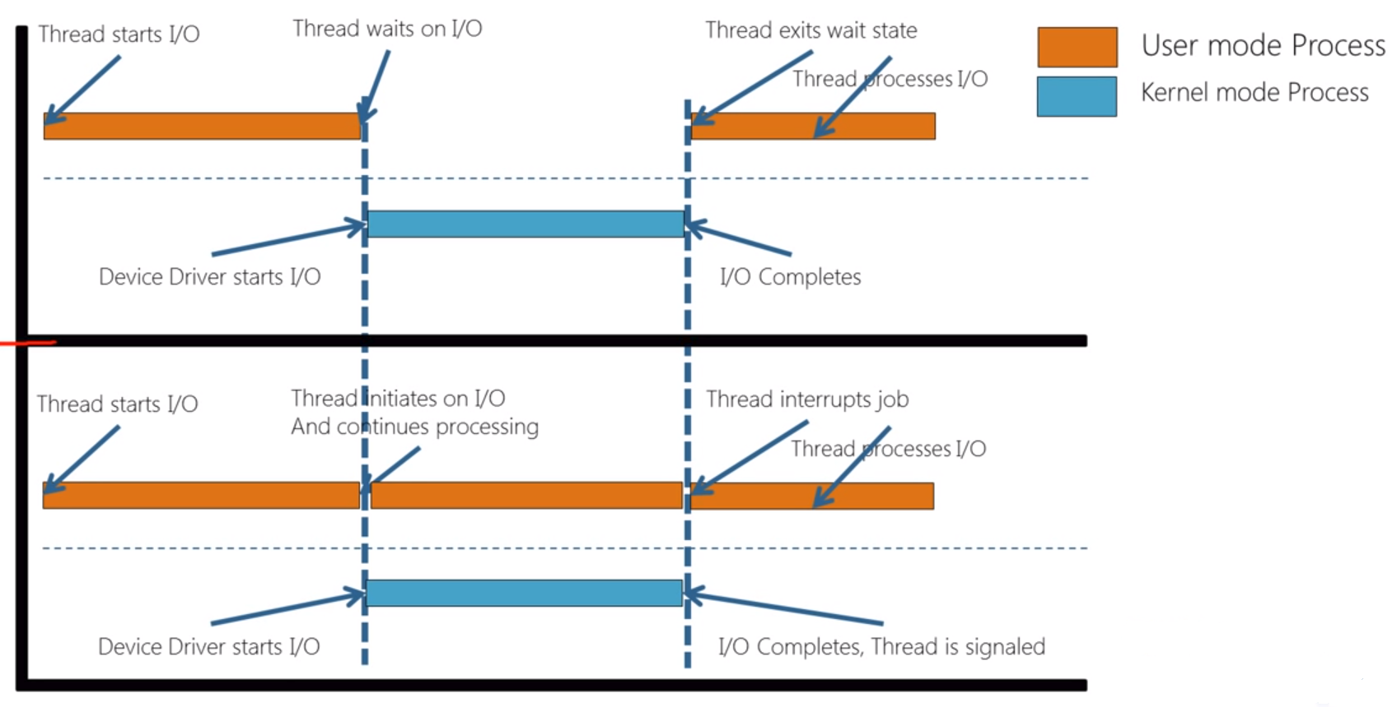
Synchronous & Async I/O
Notes:
Synchronous
Call method => Wait for result
One method at a time
Easy to program/understand
Asynchronous
Call method => Return right away
Result / method completion provided via callback
Run several methods at the same time
Scalability
Harder to program

Slide 19
Async in ASP.Net WebForms
Notes:
WebForms takeaways:
Await frees up thread until operation is finished
Using async does not affect client
Set Async page attribute to use new async pipeline
Always use RegisterAsyncTask to call async code
ASP.NET takes care of thread affinity

Slide 20
ASP.NET Asynchronous Page lifecycle
Init
Load
PreRender
Async calls
PreRender
Complete

Slide 21
Demo
Async in ASP.NET WebForm
Notes:
MVC/WebAPI takeaways:
Async is simple - just mark the action as async
Async is transparent to callers of WebAPI
Entity Framework 6 enables async database calls

Slide 22
Parallelism

Slide 23
Two types of parallelism
Multiple asynchronous operations
Two or more awaitable operations
No additional threads used
Multiple synchronous operations
Task.Run, ThreadPool.QueueUserWorkItem, etc.
Each operation uses a thread
Same thread pool as ASP.NET

Slide 24
Demo
Parallelism
Notes:
Parallelism takeaways:
Parallelism can reduce request time
Be careful with synchronous parallelism
Threads come from same pool used to serve requests

Slide 25
Async in ASP.NET WebAPI/MVC
Notes:
MVC/WebAPI takeaways:
Async is simple - just mark the action as async
Async is transparent to callers of WebAPI
Entity Framework 6 enables async database calls

Slide 26
Demo
Async in ASP.NET WebAPI/MVC
Notes:
MVC/WebAPI takeaways:
Async is simple - just mark the action as async
Async is transparent to callers of WebAPI
Entity Framework 6 enables async database calls

Slide 27
Benchmark
Notes:
MVC/WebAPI takeaways:
Async is simple - just mark the action as async
Async is transparent to callers of WebAPI
Entity Framework 6 enables async database calls

Slide 28
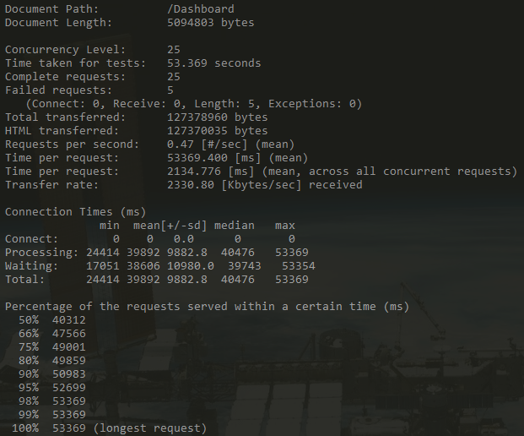
Synchronous

Slide 29
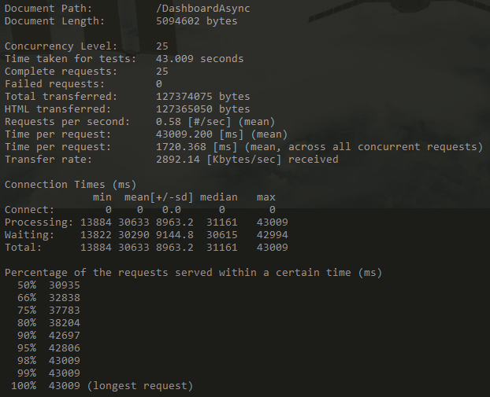
Asynchronous

Slide 30
Part 2 : Deep Dive : Asynchronous Programming in C#

Slide 31
I/O operations Error conditions

Slide 32
Demo
Cancellation tokens
Notes:
Cancellation tokens:
Allow caller to terminate an in-flight async task
ASP.NET has three built-in tokens
RequestTimeout, ClientDisconnected, & AsyncTimeout
Cancellation tokens takeaways:
Cancellation tokens further reduce thread usage
ASP.NET has built in cancellation tokens
Use CancellationTokenSource to combine tokens

Slide 33
Demo
Async in an HttpHandler

Slide 34
Tips, tricks & no-nos

Slide 35
Avoid work on “background threads”
There are no background threads on servers
All threads come form the same pool used to serve requests
Moving to another thread just adds cost
Use Task.FromResult if result needs to look async
TaskCompletionSource<T> if you need to return non-result (faulted, cancelled, etc.)

Slide 36
Using ASP.NET intrinsics on worker threads
HttpContext.Current, Request, Response, etc.
Not setup to use on worker threads you start
Async/await will take care of this for you
Provided you start using them on the request thread
Alternative is to use SynchronizationContext.Post

Slide 37
Avoid using Task.Wait
Calling Wait blocks the current thread
Task.Result on an uncompleted task also blocks
Can easily cause deadlocks in ASP.NET
Use await or Task.WhenAll instead

Slide 38
Demo
Deadlocks from using Task.Wait

Slide 39
Avoid Task.ContinueWith
ContinueWith is not aware of SynchronizationContext
Always puts you on a new thread
Use async/await instead

Slide 40
Be careful with parallelism
Multiple requests * multiple threads = a lot of threads
All threads come form the same pool used to serve requests
Threads consume min ¼Mb memory each
Kicking off multiple awaitable async tasks is fine

Slide 41
Don’t use thread local storage
You may swap physical threads
Don’t use [ThreadStatic]
Use HttpContext.Items
If your using async/await ASP.NET will take care of thread hops
Don’t assume this doesn’t apply to your sync code
Other async components in the pipeline can cause thread hops

Slide 42
Don’t call fire & forget methods
Your code could be terminated at any time
Use WebBackgrounder
http://nuget.org/packages/WebBackgrounder/
Write a worker process for more complex tasks

Slide 43
Use HttpTaskAsyncHandler
IHttpAsyncHandler is a complicated interface
HttpTaskAsyncHandler takes care of a lot for you

Slide 44

Resources
Parallel Programming with .NET Blog http://blogs.msdn.com/pfxteam/
Asynchrony in .NET Whitepaper http://msdn.com/library/vstudio/hh191443.aspx
ASP.NET Async Tutorial http://www.asp.net/web-forms/tutorials/aspnet-45/using-asynchronous-methods-in-aspnet-45
Demo / Slide
https://github.com/ranjitjc/AsyncAspNetDemo/

